Slide 1








PROJECT PORTOFOLIO
Classification Heart Failure Prediction with K-Nearest Neighbors (KNN)
By :Miftahul Jannah

Slide 2
K-Nearest Neighbors
K-Nearest Neighbor (KNN) is a machine learning algorithm used to classify new data based on existing data. This algorithm uses the concept that similar data will be close to each other.

Slide 3
Heart Failure Prediction
Cardiovascular diseases (CVDs) are the number 1 cause of death globally, taking an estimated 17.9 million lives each year, which accounts for 31% of all deaths worldwide. Four out of 5CVD deaths are due to heart attacks and strokes, and one-third of these deaths occur prematurely in people under 70 years of age. Heart failure is a common event caused by CVDs and this dataset contains 11 features that can be used to predict a possible heart disease.
People with cardiovascular disease or who are at high cardiovascular risk (due to the presence of one or more risk factors such as hypertension, diabetes, hyperlipidaemia or already established disease) need early detection and management wherein a machine learning model can be of great help.

Slide 4
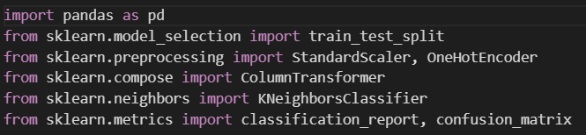
Library

Slide 5
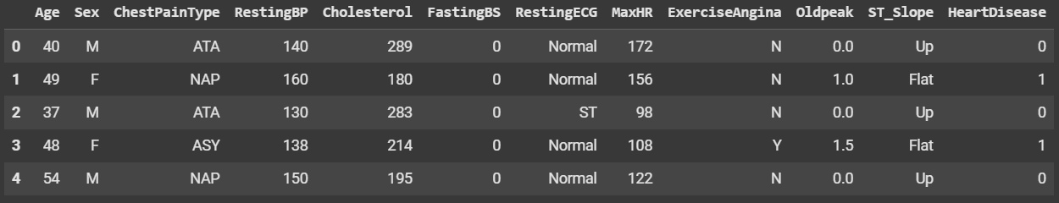
Dataset

Slide 6
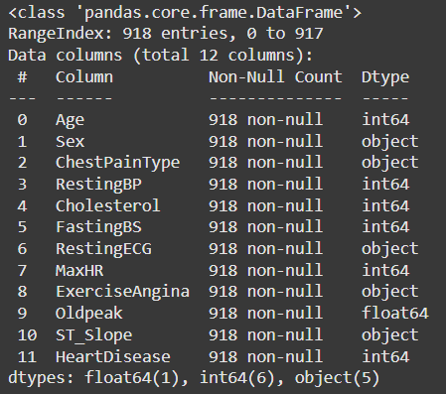
Preprocessing
There are no missing values ​​and duplicate data

Slide 7
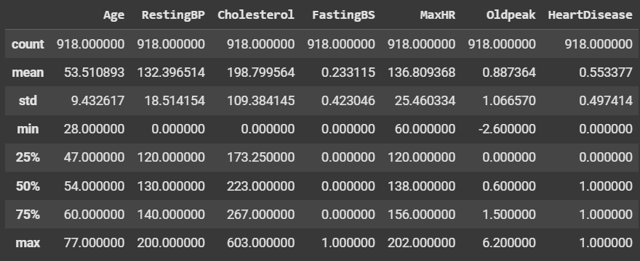
Description of the data

Slide 8
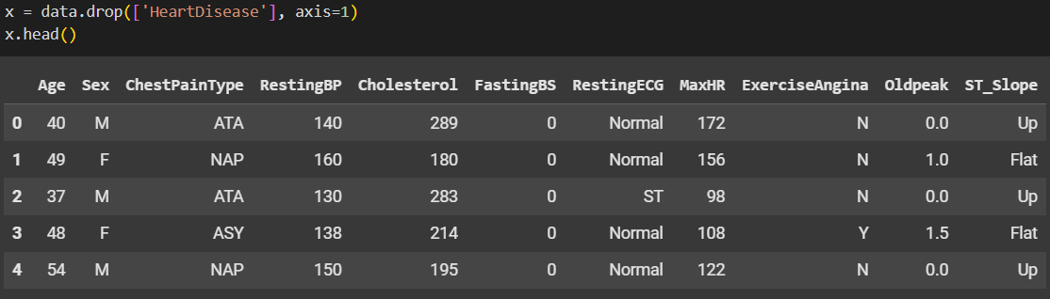
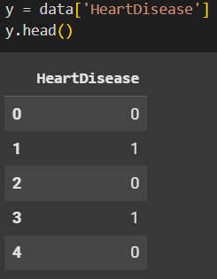
Variable Independen
Variable Dependen

Slide 9
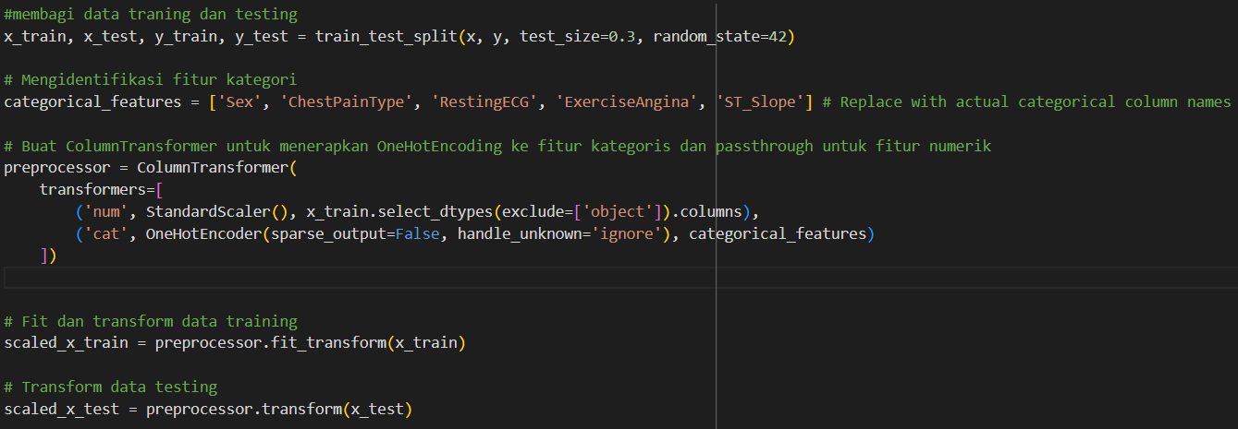
Split Data Training and Testing and Transform

Slide 10
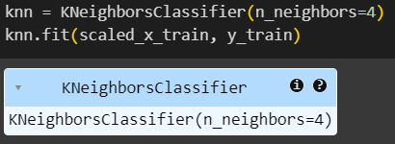
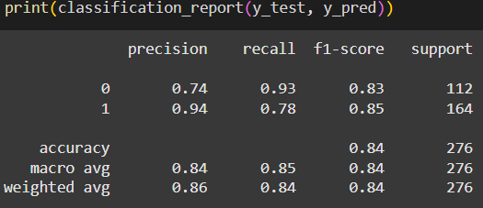
KNN Model and Result

Slide 11
Conclusion
From the results of the classification using KNN, it was found that the classification had been carried out well with an accuracy result of 86%.

Slide 12

About Me
I am a fresh graduate of S1 majoring in informatics engineering who has a high interest in the field of data analysis and data science. Currently attending a mini Bootcamp from dibimbing.id to expand my knowledge in the field of data analysis and data science

Slide 13
Thank you

